Slide 1

INSTITUTE - UIE
DEPARTMENT- ACADEMIC UNIT-2
Bachelor of Engineering (Computer Science & Engineering)
Subject Name: Introduction to Problem Solving
Code:22CSH-101
Pointers:Double pointer, pointer and array, pointer to array, array of pointers
DISCOVER . LEARN . EMPOWER

Slide 2


Introduction to Problem Solving
Course Objectives
The course aims to provide exposure to problem-solving through programming.
The course aims to raise the programming skills of students via logic building capability.
With knowledge of C programming language, students would be able to model real world problems.

Slide 3



Course Outcomes
CO Number | Course Outcome
CO1 | Remember the concepts related to fundamentals of C language, draw flowcharts and write algorithm/pseudocode.
CO2 | Understand the way of execution and debug programs in C language.
CO3 | Apply various constructs, loops, functions to solve mathematical and scientific problem.
CO4 | Analyze the dynamic behavior of memory by the use of pointers.
CO5 | Design and develop modular programs for real world problems using control structure and selection structure.

Slide 4
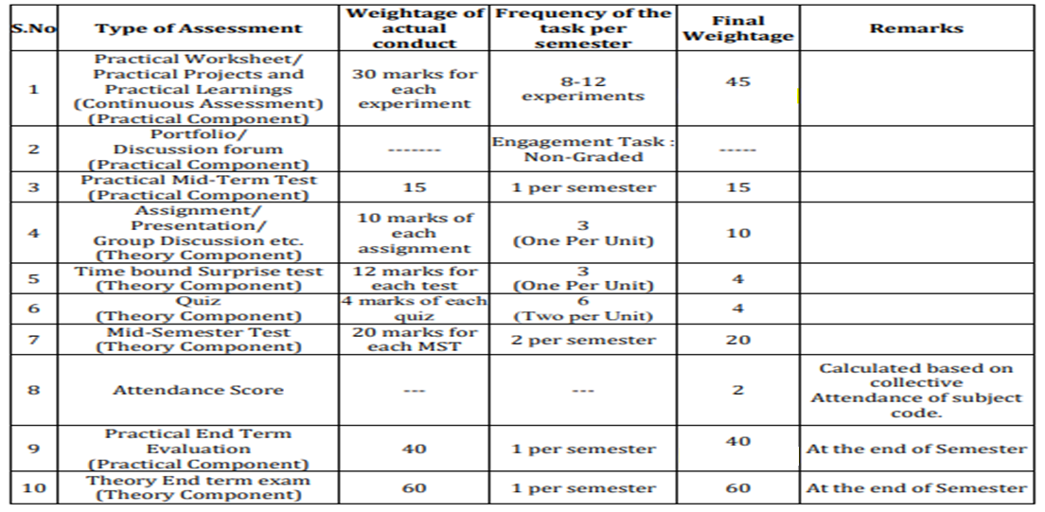
Scheme of Evaluation

Slide 5
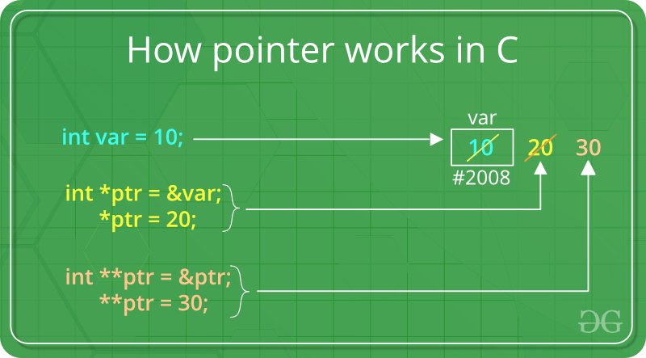
Introduction
We already know that a pointer points to a location in memory and thus used to store the address of variables.
So, when we define a pointer to pointer.
The first pointer is used to store the address of the variable.
And the second pointer is used to store the address of the first pointer.
That is why they are also known as double pointers.
Syntax:
int **ptr; // declaring double pointers
Source: https://www.geeksforgeeks.org/double-pointer-pointer-pointer-c/

Slide 6

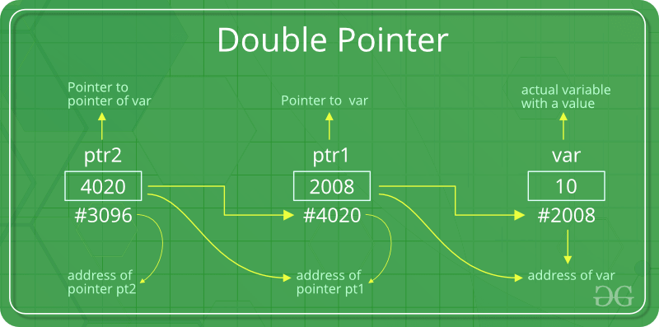
Below diagram explains the concept of Double Pointers:
Source: https://www.geeksforgeeks.org/double-pointer-pointer-pointer-c/
The above diagram shows the memory representation of a pointer to pointer. The first pointer ptr1 stores the address of the variable and the second pointer ptr2 stores the address of the first pointer.

Slide 7
Example:
#include <stdio.h>
// C program to demonstrate pointer to pointer
int main()
{
int var = 789;
// pointer for var
int *ptr2;
// double pointer for ptr2
int **ptr1;
// storing address of var in ptr2
ptr2 = &var;
// Storing address of ptr2 in ptr1
ptr1 = &ptr2;
// Displaying value of var using both single and double pointers
printf("Value of var = %d\n", var );
printf("Value of var using single pointer = %d\n", *ptr2 );
printf("Value of var using double pointer = %d\n", **ptr1);
return 0;
}
Output:
Value of var = 789
Value of var using single pointer = 789
Value of var using double pointer = 789

Slide 8
Pointer Arithmetic
We can perform arithmetic operations on the pointers like addition, subtraction, etc.
However, as we know that pointer contains the address, the result of an arithmetic operation performed on the pointer will also be a pointer if the other operand is of type integer.
In pointer-from-pointer subtraction, the result will be an integer value.
Following arithmetic operations are possible on the pointer in C language:
Increment
Decrement
Addition
Subtraction
Comparison

Slide 9
Incrementing Pointer in C
If we increment a pointer by 1, the pointer will start pointing to the immediate next location.
This is somewhat different from the general arithmetic since the value of the pointer will get increased by the size of the data type to which the pointer is pointing.
We can traverse an array by using the increment operation on a pointer which will keep pointing to every element of the array, perform some operation on that, and update itself in a loop.
The Rule to increment the pointer is given below:
new_address= current_address + i * size_of(data type)
where i is the number by which the pointer get increased.

Slide 10
Example: Traversing an array by using pointer
#include<stdio.h>
void main ()
{
int arr[5] = {1, 2, 3, 4, 5};
int *p = arr;
int i;
printf("printing array elements...\n");
for(i = 0; i< 5; i++)
{
printf("%d ",*(p+i));
}
}
Output:
printing array elements...
1 2 3 4 5
Note:
32-bit
For 32-bit int variable, it will be incremented by 2 bytes.
64-bit
For 64-bit int variable, it will be incremented by 4 bytes.

Slide 11
Decrementing Pointer in C
Like increment, we can decrement a pointer variable.
If we decrement a pointer, it will start pointing to the previous location.
The formula of decrementing the pointer is given below:
new_address= current_address - i * size_of(data type)
Note:
32-bit: For 32-bit int variable, it will be decremented by 2 bytes.
64-bit: For 64-bit int variable, it will be decremented by 4 bytes.

Slide 12
Example: Decrementing pointer variable on 64-bit OS.
#include <stdio.h>
void main(){
int number=50;
int *p;//pointer to int
p=&number;//stores the address of number variable
printf("Address of p variable is %u \n",p);
p=p-1;
printf("After decrement: Address of p variable is %u \n",p); // P will now point to the immediate previous location.
}
Output:
Address of p variable is 3214864300
After decrement: Address of p variable is 3214864296

Slide 13
C Pointer Addition
We can add a value to the pointer variable.
The formula of adding value to pointer is given below:
new_address= current_address + (number * size_of(data type))
Note:
32-bit: For 32-bit int variable, it will add 2 * number.
64-bit: For 64-bit int variable, it will add 4 * number.

Slide 14
Example: Adding value to pointer variable on 64-bit architecture.
#include<stdio.h>
int main(){
int number=50;
int *p;//pointer to int
p=&number;//stores the address of number variable
printf("Address of p variable is %u \n",p);
p=p+3; //adding 3 to pointer variable
printf("After adding 3: Address of p variable is %u \n",p);
return 0;
}
Output:
Address of p variable is 3214864300
After adding 3: Address of p variable is 3214864312
As you can see, the address of p is 3214864300. But after adding 3 with p variable, it is 3214864312, i.e., 4*3=12 increment. Since we are using 64-bit architecture, it increments 12. But if we were using 32-bit architecture, it was incrementing to 6 only, i.e., 2*3=6. As integer value occupies 2-byte memory in 32-bit OS.

Slide 15
C Pointer Subtraction
Like pointer addition, we can subtract a value from the pointer variable. Subtracting any number from a pointer will give an address.
The formula of subtracting value from the pointer variable is given below:
new_address= current_address - (number * size_of(data type))
Note:
32-bit:For 32-bit int variable, it will subtract 2 * number.
64-bit:For 64-bit int variable, it will subtract 4 * number.

Slide 16
Example: Subtracting value from the pointer variable on 64-bit architecture.
#include<stdio.h>
int main(){
int number=50;
int *p;//pointer to int
p=&number;//stores the address of number variable
printf("Address of p variable is %u \n",p);
p=p-3; //subtracting 3 from pointer variable
printf("After subtracting 3: Address of p variable is %u \n",p);
return 0;
}
Output:
Address of p variable is 3214864300
After subtracting 3: Address of p variable is 3214864288
You can see after subtracting 3 from the pointer variable, it is 12 (4*3) less than the previous address value.
However, instead of subtracting a number, we can also subtract an address from another address (pointer).
This will result in a number.
It will not be a simple arithmetic operation, but it will follow the following rule.

Slide 17
If two pointers are of the same type,
Address2 - Address1 = (Subtraction of two addresses)/size of data type which pointer points
Consider the following example to subtract one pointer from an another.
#include<stdio.h>
void main ()
{
int i = 100;
int *p = &i;
int *temp;
temp = p;
p = p + 3;
printf("Pointer Subtraction: %d - %d = %d",p, temp, p-temp);
}
Output:
Pointer Subtraction: 1030585080 - 1030585068 = 3

Slide 18
Illegal arithmetic with pointers
There are various operations which can not be performed on pointers.
Since, pointer stores address hence we must ignore the operations which may lead to an illegal address, for example, addition, and multiplication.
A list of such operations is given below.
Address + Address = illegal
Address * Address = illegal
Address % Address = illegal
Address / Address = illegal
Address & Address = illegal
Address ^ Address = illegal
Address | Address = illegal
~Address = illegal

Slide 19
Summary
We can perform arithmetic operations on the pointers like addition, subtraction, etc.
Declaring Pointer to Pointer is similar to declaring pointer in C. The difference is we have to place an additional ‘*’ before the name of pointer.
When an array is declared, compiler allocates sufficient amount of memory to contain all the elements of the array.
You cannot decrement a pointer once incremented. p-- won't work
Base address i.e address of the first element of the array is also allocated by the compiler.

Slide 20
Frequently Asked question
Q1:Write a C program to Biggest value in the array using pointers in C
Solution:
#include <stdio.h> int main() { long array[100], *maximum, size, c, location = 1; printf("Enter the number of elements in array\n"); scanf("%ld", &size); printf("Enter %ld integers\n", size); for ( c = 0 ; c < size ; c++ ) scanf("%ld", &array[c]); maximum = array; *maximum = *array; | for (c = 1; c < size; c++) { if (*(array+c) > *maximum) { *maximum = *(array+c); location = c+1; } } printf("Maximum element is present at location number %ld and it's value is %ld.\n", location, *maximum); return 0; }

Slide 21
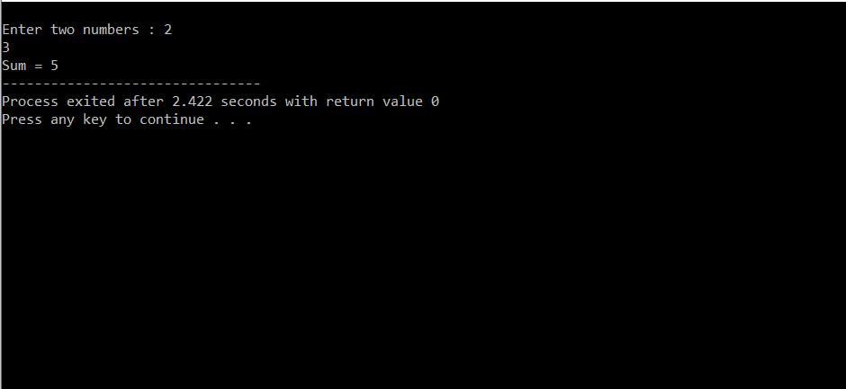
2) Write C Program to Add Two Numbers Using Pointer
Solution:
#include<stdio.h>
int main() {
int *ptr1, *ptr2;
int num;
printf("\nEnter two numbers : ");
scanf("%d %d", ptr1, ptr2);
num = *ptr1 + *ptr2;
printf("Sum = %d", num);
return (0);
}
Output:

Slide 22
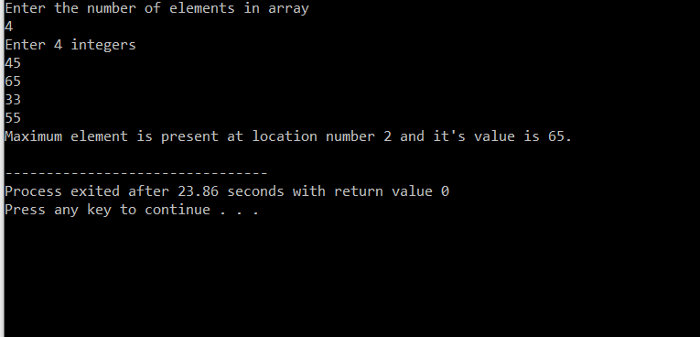
Output:

Slide 23
Q3) What is “&” and “*” operators in C?
Ans:
1. “*” Operator is used as pointer to a variable. Example: * a where * is pointer to the variable a.
& operator is used to get the address of the variable. Example: &a will give address of a.
Q4) WHAT IS VOID POINTER IN C?
Ans:
Void pointer is a generic pointer that can be used to point another variable of any data type.
Void pointer can store the address of variable belonging to any of the data type. So, void pointer is also called as general purpose pointer.

Slide 24
Assessment Questions:
C Program to compute sum of the array elements using pointers ?
Write a C program to Find transpose of a matrix.
Write a C program to find the length of string using pointers.
What will be the output of the C program?
#include<stdio.h>
#include<string.h>
int main(){
char *ptr = "hello";
char a[22];
*ptr = "world";
printf("\n%s %s",ptr, a);
return 0;
}
What will be the output of the C program?
#include<stdio.h>
int main(){
int i = 3;
int *j;
int **k;
j = &i;
k = &j;
k++;
printf("%d ",**k);
return 0;
}

Slide 25

Discussion forum.
C Program to read integers into an array and reversing them using pointers

Slide 26

REFERENCES
Reference Books
Programming in C by Reema Thareja.
Programming in ANSI C by E. Balaguruswamy, Tata McGraw Hill.
Programming with C (Schaum's Outline Series) by Byron Gottfried Jitender Chhabra, Tata McGraw Hill.
The C Programming Language by Brian W. Kernighan, Dennis Ritchie, Pearson education.
Websites:
https://www.geeksforgeeks.org/double-pointer-pointer-pointer-c/
https://www.javatpoint.com/pointer-arithmetic-in-c#:~:text=%E2%86%92%20%E2%86%90%20prev-,Pointer%20Arithmetic%20in%20C,operand%20is%20of%20type%20integer.&text=Subtraction,-Comparison
https://www.studytonight.com/c/pointers-with-array.php
YouTube Links:
https://www.youtube.com/watch?v=ahKfY1EsWd8&t=1s
https://www.youtube.com/watch?v=jYuqC9UD4GI
https://www.youtube.com/watch?v=kKKvGYAX_Zs

Slide 27
THANK YOU

